Slide 1
Quick sort
By
Tanvir Ahammad
Lecturer
Dept. of JnU, Bangladesh

Slide 2
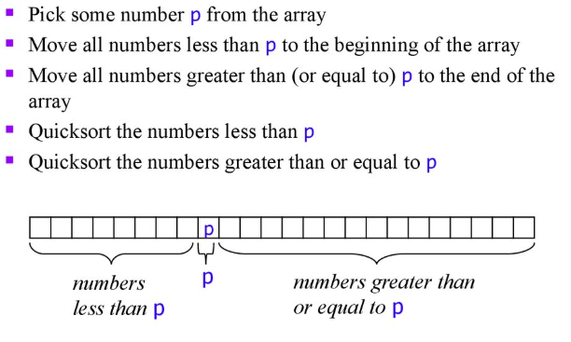
Basic idea about quick sort

Slide 3
Partitioning
It is most important phase
Every time portioning happens and then places the pivot in its right place
This process continues recursively and solve the problem as divide and conquer fashion, i.e.
Divide: divide (partition) the array into two sub arrays
Conquer: Sort the sub arrays by calling quick sort recursively
Combine: As the sub arrays are sorted, no need to perform any work in this step. The array A[i…j] is sorted

Slide 4


Example-partitioning
$p→beggining index;$
$r→ending index$;
$i→partioned index;$
$j→loop counter$

Slide 5

Example-partitioning
$p→beggining index;$
$r→ending index$;
$i→partioned index;$
$j→loop counter$

Slide 6

Example-partitioning
$p→beggining index;$
$r→ending index$;
$i→partioned index;$
$j→loop counter$

Slide 7

Example-partitioning
$p→beggining index;$
$r→ending index$;
$i→partioned index;$
$j→loop counter$

Slide 8

Example-partitioning
$p→beggining index;$
$r→ending index$;
$i→partioned index;$
$j→loop counter$

Slide 9

Example-partitioning
$p→beggining index;$
$r→ending index$;
$i→partioned index;$
$j→loop counter$

Slide 10

Example-partitioning
$p→beggining index;$
$r→ending index$;
$i→partioned index;$
$j→loop counter$

Slide 11
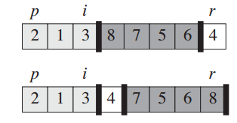

Example-partitioning
$p→beggining index;$
$r→ending index$;
$i→partioned index;$
$j→loop counter$

Slide 12
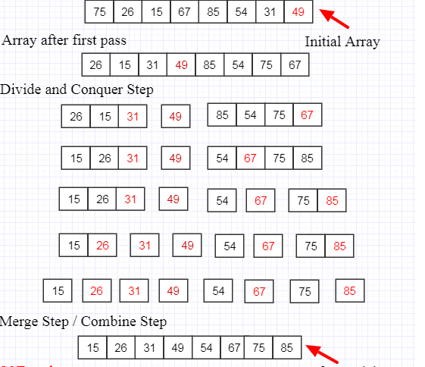
Example- quick sort

Slide 13
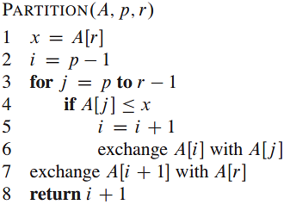
Partitioning procedure

Slide 14
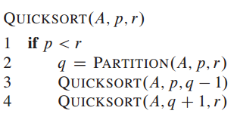
Quick sort algorithm
To sort array using this algorithm, the initial call should be QUICKSORT(A, 1, A.length)

Slide 15

Analysis of quick sort
Initialization
Maintenance
Termination

Slide 16
Exercise
Illustrate the operation of PARTITION on the array A={13; 19; 9; 5; 12; 8; 7; 4; 21; 2; 6; 11}

Slide 17
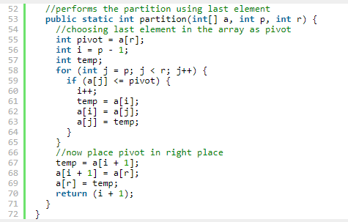
Pseudocode

Slide 18
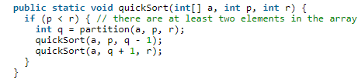
Pseudocode

Slide 19
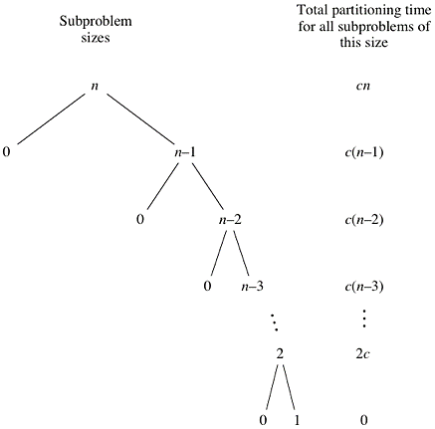

Complexity analysis
The worst occurs in the following cases.
Array is already sorted in the same order.
Array is already sorted in reverse order.
All elements are the same (a special case of cases 1 and 2)
last line is arithmetic series
Complexity O(n^2)

Slide 20
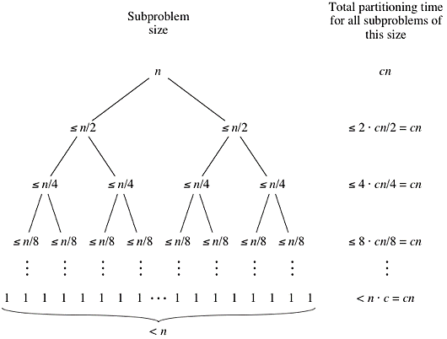
Complexity analysis
Quicksort's best case occurs when the partitions are as evenly balanced as possible: their sizes either are equal or are within 1 of each other.
Complexity same as merge sort, Ω(n lg n)

